Slide 1
Instructor Materials Chapter 5: The Art of Ensuring Integrity
Cybersecurity Essentials v1.0
Notes:
Cisco Networking Academy Program
Cybersecurity Essentials
Chapter 5: The Art of Ensuring Integrity

Slide 2
Instructor Materials - Chapter 5 Planning Guide
This PowerPoint deck is divided in two parts:
Instructor Planning Guide
Information to help you become familiar with the chapter
Teaching aids
Instructor Class Presentation
Optional slides that you can use in the classroom
Begins on slide #11
Note: Remove the Planning Guide from this presentation before sharing with anyone.
Notes:
2

Slide 3
Cybersecurity Essentials v1.0
Planning Guide
Chapter 5: The Art of Ensuring Integrity
Notes:
Cybersecurity Essentials v1.0 Planning Guide
Chapter 5: The Art of Ensuring Integrity

Slide 4
Chapter 5: Activities
What activities are associated with this chapter?
The password used in the Packet Tracer activities in this chapter is:
Not applicable for this chapter.
Page Number | Activity Type | Activity Name
5.1.1.0 | IA | Identify Hashing Terminology
5.1.2.4 | Lab | Password Cracking
5.2.2.4 | Lab | Using Digital Signatures
5.3.2.4 | IA | Order the Steps in the Certificate Process
5.4.2.5 | IA | Identify the Database Integrity Controls
5.4.3.4 | Lab | Remote Access
Notes:
4

Slide 5
Chapter 5: Assessment
Students should complete Chapter 5, “Assessment” after completing Chapter 5.
Quizzes, labs, Packet Tracers and other activities can be used to informally assess student progress.
Notes:
5

Slide 6
Chapter 5: Best Practices
Prior to teaching Chapter 5, the instructor should:
Complete Chapter 5, “Assessment.”
The concepts and topics covered here will follow the students through their cybersecurity career. Make sure to take your time to eliminate any misconceptions.
This chapter presents the concepts and methods used to ensure data integrity. Make time to ensure students understand the concept of data integrity and the threats to data integrity.
Have students use a hash calculator to hash text, files and data strings. Point out the differences between the different types of hashing algorithms.
Secure hashing is also introduced in this chapter. Have students use both salting and HMACs to see how hash values can be authenticated.
Notes:
6

Slide 7
Chapter 5: Best Practices (Cont.)
This slide can be used to start a class discussion.
Introduce the three dimensions of The Art of Ensuring Integrity. Challenge the students to give examples of security controls from the 27 intersections of the cube.
Example: All VPN connections must include integrity checks.
Notes:
7

Slide 8
Chapter 5: Best Practices (Cont.)
Encourage students to explore each of the major topics in this chapter. Data integrity is a foundation concept and students should be given time to explore the different methods, technologies and products that provide data integrity.
Data Integrity | URL Address
8-bit Checksum Calculator | http://easyonlineconverter.com/converters/checksum_converter.html
Fileformat.Info – Hash Functions | http://www.fileformat.info/tool/hash.htm
HMAC Generator / Tester Tool | http://www.freeformatter.com/hmac-generator.html
Online Code Generator – Hashing with Salting | http://online-code-generator.com/sha1-hash-with-optional-salt.php
Cracking MD5 – Cracking | http://md5cracker.org/
Notes:
8

Slide 9
Chapter 5: Additional Help
For additional help with teaching strategies, including lesson plans, analogies for difficult concepts, and discussion topics, visit the Cybersecurity Essentials Community at community.netacad.net.
If you have lesson plans or resources that you would like to share, upload them to the Cybersecurity Essentials Community in order to help other instructors.
Notes:
9

Slide 10


Slide 11
Chapter 5: The Art of Ensuring Integrity
Cybersecurity Essentials v1.0
Notes:
Cisco Networking Academy Program
Cybersecurity Essentials v1.0
Chapter 5: The Art of Ensuring Integrity

Slide 12
Chapter 5 - Sections & Objectives
5.1 Types of Data Integrity Controls
Explain the processes used to ensure integrity.
5.2 Digital Signatures
Explain the purpose of digital signatures.
5.3 Certificates
Explain the purpose of digital certificates.
5.4 Database Integrity Enforcement
Explain the need for database integrity enforcement.
Notes:
12

Slide 13
5.1 Types of Data Integrity Controls
Notes:
Cisco Networking Academy Program
Cybersecurity Essentials
Chapter 5: The Art of Ensuring Integrity

Slide 14
Types of Data Integrity Controls Hashing Algorithms
Hashing is a tool that ensures data integrity by taking binary data (the message) and producing a fixed-length representation called the hash value or message digest.
Hashing is a one-way mathematical function that is relatively easy to compute, but significantly harder to reverse. Grinding coffee beans is a good analogy of a one-way function. It is easy to grind coffee beans, but it is almost impossible to put all of the tiny pieces back together to rebuild the original beans.
A cryptographic hash function has the following properties:
The input can be any length.
The output has a fixed length.
The hash function is one way and is not reversible.
Two different input values will always result in different hash values.

Slide 15
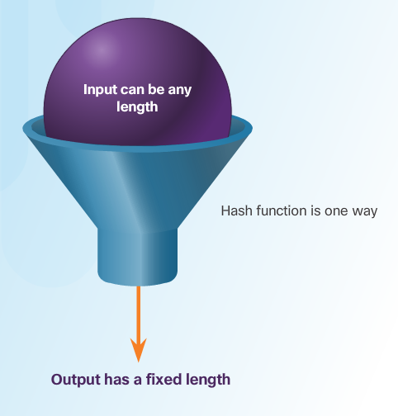
Types of Data Integrity Controls Hashing Algorithms
There are many modern hashing algorithms widely used today. Two of the most popular are MD5 and SHA.
Message Digest 5 (MD5) Algorithm - is a hash algorithm developed by Ron Rivest that produces a 128-bit hash value.
Secure Hash Algorithm (SHA) – was developed by the U.S. National Institute of Standards and Technology (NIST) and can be implemented in different strengths:
SHA-224 (224 bit)
SHA-256 (256 bit)
SHA-384 (384 bit)
SHA-512 (512 bit)

Slide 16
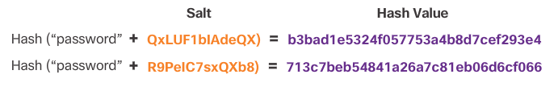
Types of Data Integrity Controls Salting
Salting is used to make hashing more secure. If two users have the same password, they will also have the same password hashes. A salt, which is a random string of characters, is an additional input to the password before hashing.
This creates a different hash result for the two passwords as shown in the figure. A database stores both the hash and the salt.

Slide 17
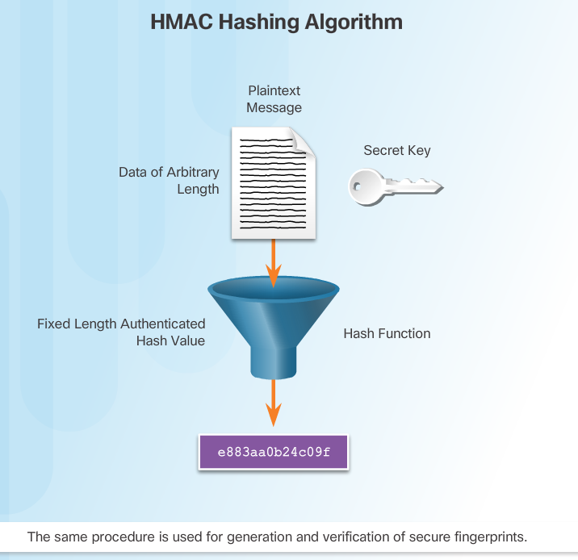
Types of Data Integrity Controls HMAC
HMACs strengthens hashing algorithms by using an additional secret key as input to the hash function.
The use of HMAC goes a step further than just integrity assurance by adding authentication.
An HMAC uses a specific algorithm that combines a cryptographic hash function with a secret key, as shown in the figure.

Slide 18
5.2 Digital Signatures
Notes:
Cisco Networking Academy Program
Cybersecurity Essentials
Chapter 5: The Art of Ensuring Integrity

Slide 19
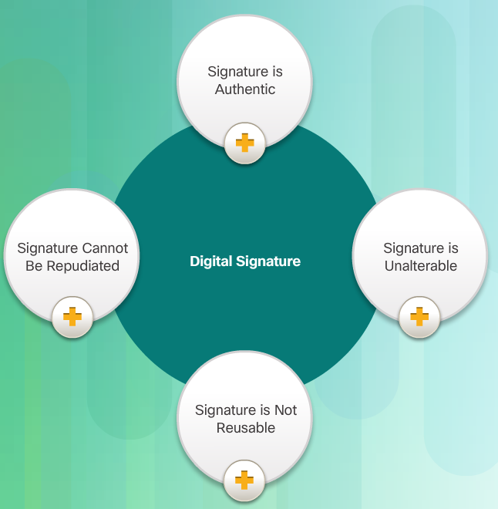
Digital Signatures Signatures and the Law
Digital signatures provide the same functionality as handwritten signatures for electronic documents.
A digital signature is used to determine if someone edits a document after the user signs it.
A digital signature is a mathematical method used to check the authenticity and integrity of a message, digital document, or software.
In many countries, digital signatures have the same legal importance as a manually signed document.
Digital signatures also provide repudiation.

Slide 20
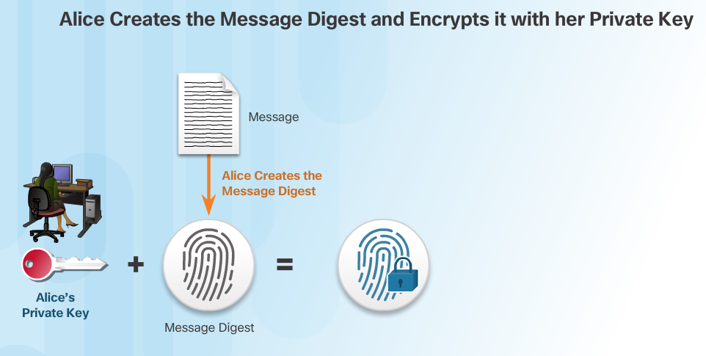
Digital Signatures How Digital Signature Technology Works
Asymmetric cryptography is the basis for digital signatures. A public key algorithm like RSA generates two keys: one private and the other public. The keys are mathematically related.

Slide 21
5.3 Certificates
Notes:
Cisco Networking Academy Program
Cybersecurity Essentials
Chapter 5: The Art of Ensuring Integrity

Slide 22
Certificates The Basics of Digital Certicates
A digital certificate is equivalent to an electronic passport.
Digital certificates enable users, hosts, and organizations to exchange information securely over the Internet.
A digital certificate authenticates and verifies that users sending a message are who they claim to be.
Digital certificates can also provide confidentiality for the receiver with the means to encrypt a reply.

Slide 23
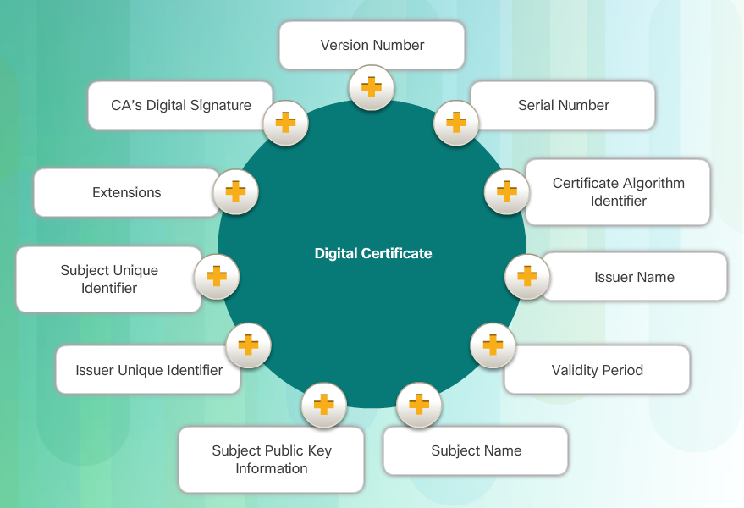
Certificates Constructing a Digital Certificate
Digital certificate must follow a standard structure so that any entity can read and understand it regardless of the issuer.
TheX.509 is the standard for construction of digital certificates and the public key infrastructure (PKI) used to manage digital certificates.
PKI is the policies, roles, and procedures required to create, manage, distribute, use, store, and revoke digital certificates.

Slide 24
5.4 Database Integrity Enforcement
Notes:
Cisco Networking Academy Program
Cybersecurity Essentials
Chapter 5: The Art of Ensuring Integrity

Slide 25
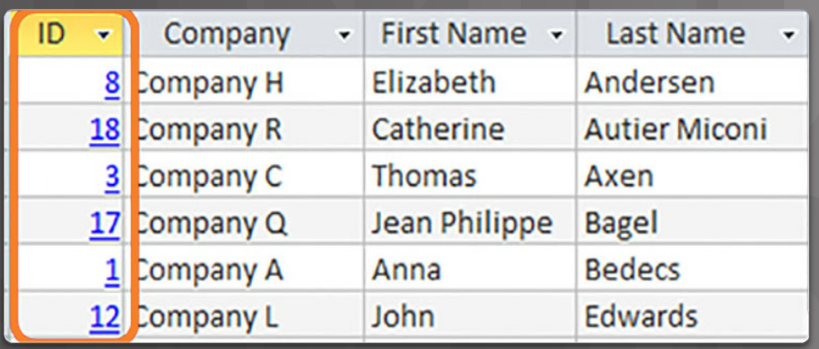
Database Integrity Enforcement Database Integrity
Databases provide an efficient way to store, retrieve, and analyze data.
As data collection increases and data becomes more sensitive, it is important for cybersecurity professionals to protect the growing number of databases.
Data integrity refers to the accuracy, consistency, and reliability of data stored in a database.

Slide 26
Database Integrity Enforcement Database Integrity (Cont.)
The four database integrity rules or constraints are as follows:
Entity Integrity: All rows must have a unique identifier called a Primary Key.
Domain Integrity: All data stored in a column must follow the same format and definition.
Referential Integrity: Table relationships must remain consistent. Therefore, a user cannot delete a record which is related to another one.
User-defined Integrity: A set of rules defined by a user which does not belong to one of the other categories. For example, a customer places a new order. The user first checks to see if this is a new customer. If it is, the user adds the new customer to the customers table.

Slide 27
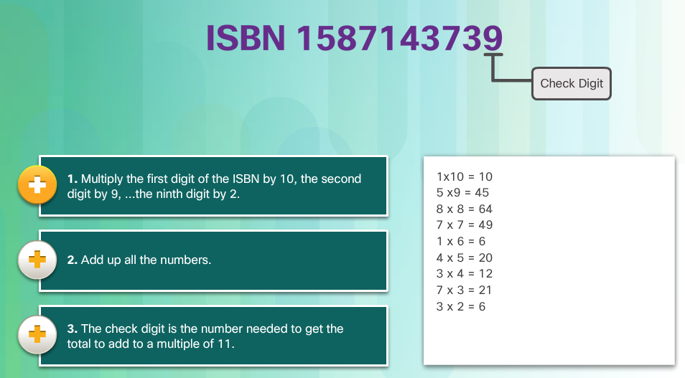
Database Integrity Enforcement Database Validation
A validation rule checks that data falls within the parameters defined by the database designer. A validation rule helps to ensure the completeness, accuracy and consistency of data. The criteria used in a validation rule include the following:
Size – checks the number of characters in a data item
Format – checks that the data conforms to a specified format
Consistency – checks for the consistency of codes in related data items
Range – checks that data lies within a minimum and maximum value
Check digit – provides for an extra calculation to generate a check digit for error detection.

Slide 28
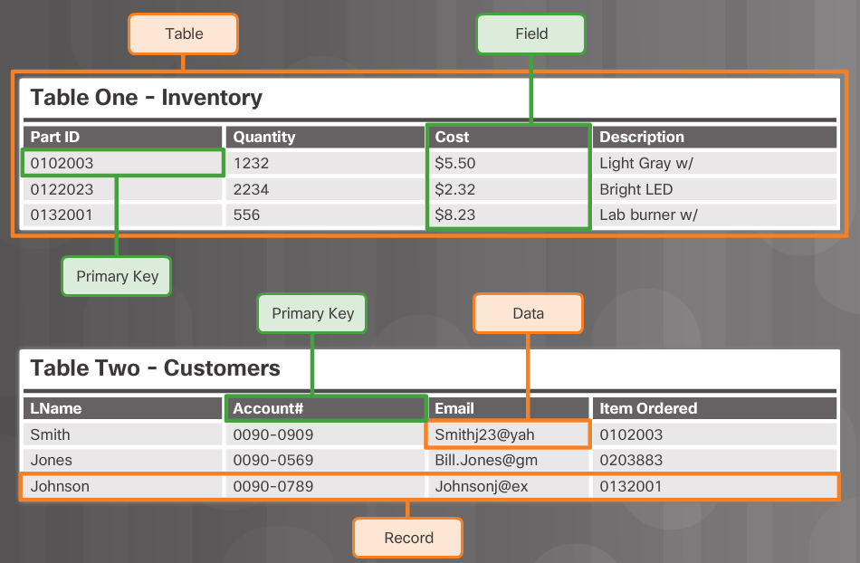
Database Integrity Enforcement Database Integrity Requirements
Maintaining proper filing is critical in maintaining the trustworthiness and usefulness of the data within the database.
Tables, records, fields, and data within each field make up a database.
In order to maintain the integrity of the database filing system, users must follow certain rules.
Entity integrity is an integrity rule, which states that every table must have a primary key and that the column or columns chosen to be the primary key must be unique and not NULL.
Null in a database signifies missing or unknown values. Entity integrity enables proper organization of data for that record.

Slide 29
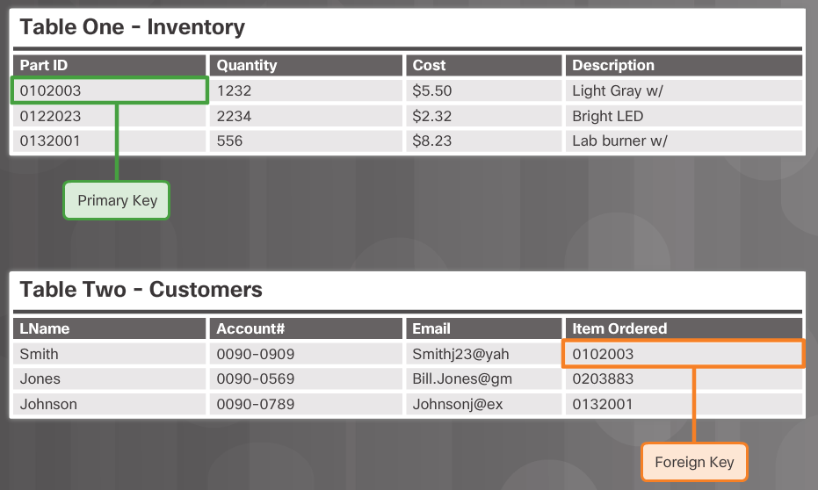
Database Integrity Enforcement Database Integrity Requirements (Cont.)
Another important integrity check is referential integrity which deals with foreign keys. A foreign key in one table references a primary key in a second table. The primary key for a table uniquely identifies entities (rows) in the table. Referential integrity maintains the integrity of foreign keys.

Slide 30
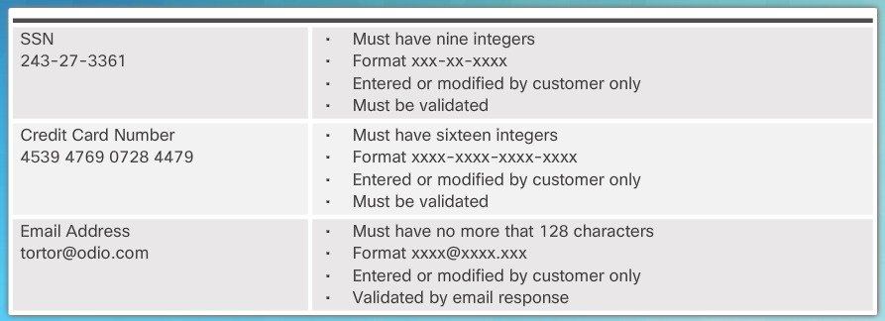
Database Integrity Enforcement Database Integrity Requirements (Cont.)
Domain integrity ensures that all the data items in a column fall within a defined set of valid values. Each column in a table has a defined set of values, such as the set of all numbers for credit card numbers, social security numbers, or email addresses. Limiting the value assigned to an instance of that column (an attribute) enforces domain integrity. Domain integrity enforcement can be as simple as choosing the correct data type, length and or format for a column.

Slide 31
5.5 Chapter Summary
Notes:
Cisco Networking Academy Program
Cybersecurity Essentials
Chapter 5: The Art of Ensuring Integrity

Slide 32
Chapter Summary Summary
Chapter five presented the art of integrity which is used to ensure that data remains unchanged by anyone or anything over its entire life cycle.
The chapter introduced types of data integrity controls including:
hashing algorithms
password salting
keyed-hash message authentication code (HMAC)
These tools provide a way for cybersecurity specialists to verify the authenticity of messages and documents.
The chapter concluded with a discussion of database integrity enforcement.
Having a well-controlled and well-defined data integrity system increases the stability, performance, and maintainability of a database system.
Notes:
1.6.1.1 - Summary

Slide 34


